Slide 1
Preliminary Study of MATLAB Analysis of Dynamic Systems
SOEN385
Control Systems and Applications

Slide 2
Control System Toolbox
4 basic types of LTI models
  Transfer Function (TF)
  Zero-Pole-Gain Model (ZPK)
  State-Space Models (SS)
  Frequency Response Data Model (FRD)
Conversion between models
Model properties (dynamics)

Slide 3
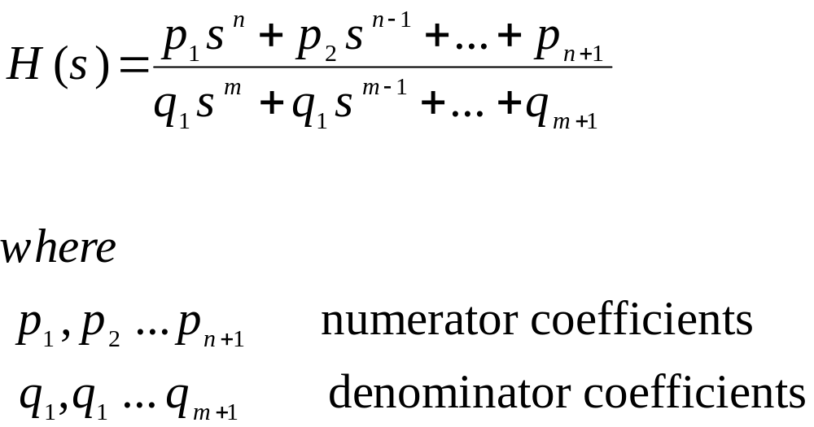
Transfer Function

Slide 4
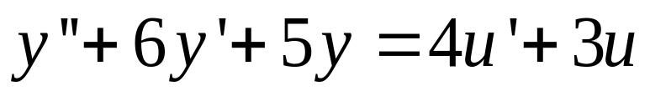
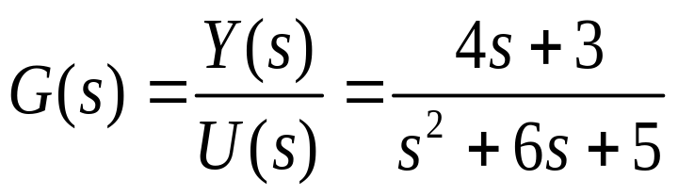
Transfer Function
Consider a LTI SISO system:
Applying Laplace Transform to both sides with zero initial conditions:

Slide 5
Transfer Function
>> num = [4 3];
>> den = [1 6 5];
>> sys = tf(num,den)
  Transfer function:
  4 s + 3
  -----------------
  s^2 + 6 s + 5
>> [num,den] =
tfdata(sys,'v')
num =
0 4 3
den =
1 6 5

Slide 6
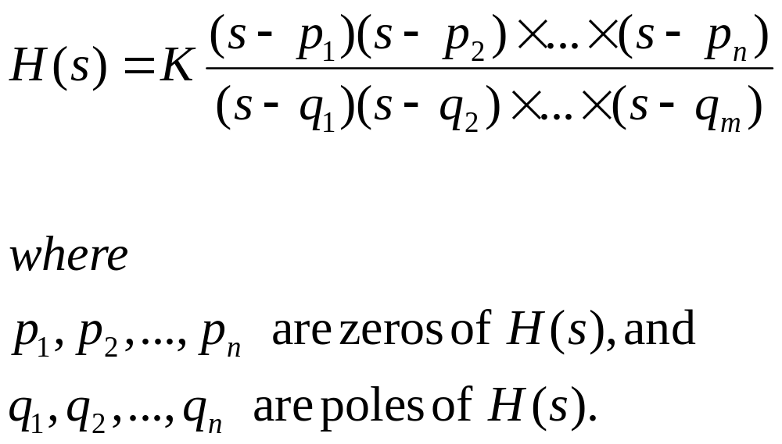
Zero-Pole-Gain Model (ZPK)

Slide 7
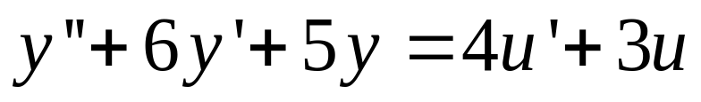
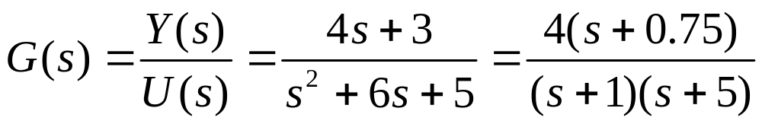
Zero-Pole-Gain Model
Consider a LTI SISO system:
Applying Laplace Transform to both sides with zero initial conditions:

Slide 8
Zero-Pole-Gain Model
>> [ze,po,k] = zpkdata(sys1,'v')
ze =
-0.7500
po =
-1
-5
k =
4
>> sys1 =
zpk(-0.75,[-1 -5],4)
Zero/pole/gain:
4 (s+0.75)
-----------
(s+1) (s+5)

Slide 9
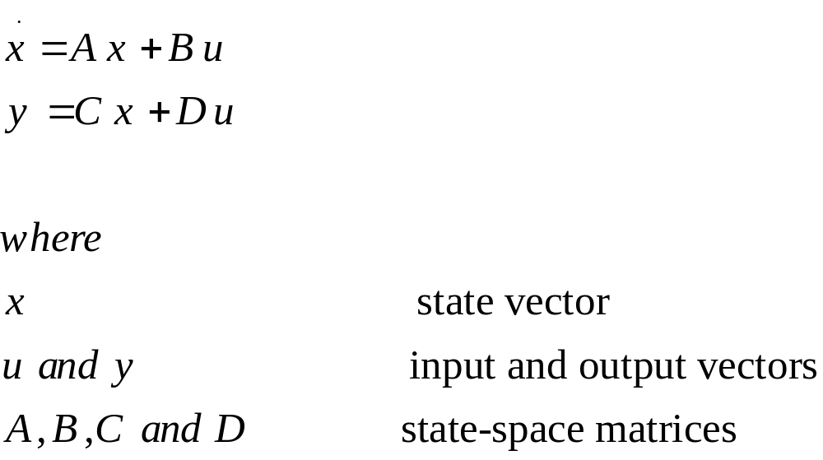
State-Space Model (SS)

Slide 10
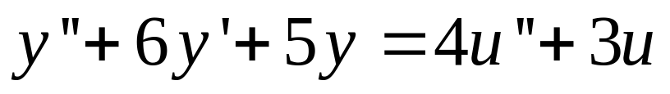
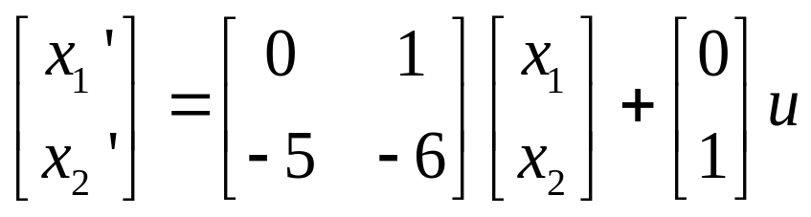
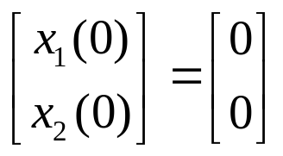
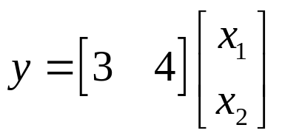
State-Space Model
Consider a Linear time invariant (LTI) single-input/single-output system
State-space model for this system is

Slide 11
State-Space Model
>> sys = ss([0 1; -5 -6],[0;1],[3,4],0)
a =
x1 x2
x1 0 1
x2 -5 -6
b =
u1
x1 0
x2 1
c =
x1 x2
y1 3 4
d =
u1
y1 0

Slide 12
Conversion Between Models
tf2ss
State Space
Transfer function
ss2tf
zp2tf
ss2zp
tf2zp
zp2ss
Zero-pole-gain

Slide 13
Refrences
MATLAB for Control Engineers, K. Ogata, Prentice Hall, 2008.
MATLAB
The Language of Technical Computing
Programming Version 7
http://www.mathworks.com/access/helpdesk/help/pdf_doc/matlab/matlab_prog.pdf

